Slide 1
Networks in their surrounding contexts
Summary by Lu and Jin

Slide 2
Outline
Homophily
Affiliation
Tracking link formation in online data
Schelling’s model

Slide 3
Homophily
the principle that we tend to be like our friends
Social links form:
Intrinsic
Social environments

Slide 4
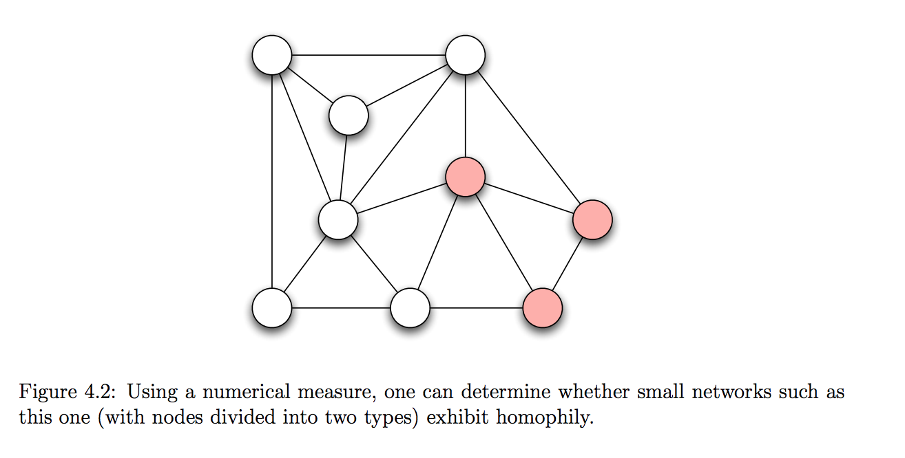
Measuring Homophily
Suppose with no homophily, friendships are formed as though there were random mixing across given characteristics. If there is homophily, we should see if the cross-charateristic edge is significantly less than random mixing.

Slide 5
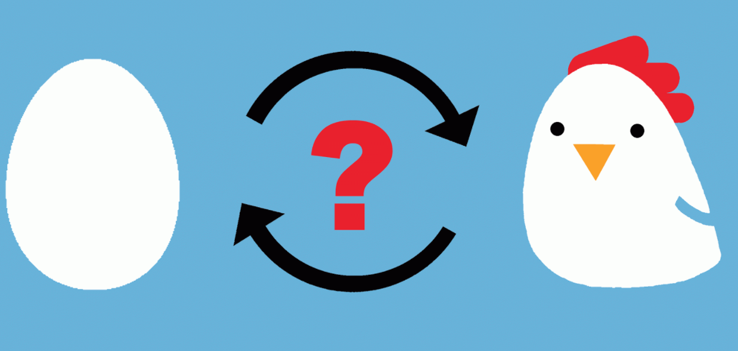
Mechanisms underlying homophily
Selection or Social influence
selection (more immutable) (you choose to be friends with those similar to you in some characteristics)
social influence (immutable and mutable) people may modify their behaviors so that they are more similar to their friends.
Longitudinal studies can help to understand the interplay between the two mechanisms
Implications: e.g. interventions. If social network formed more by social influence, through influencing the behavior of targeted person, the whole network’s behaviors could be modified (e.g drug use, obesity)
(like chicken-egg question)

Slide 6
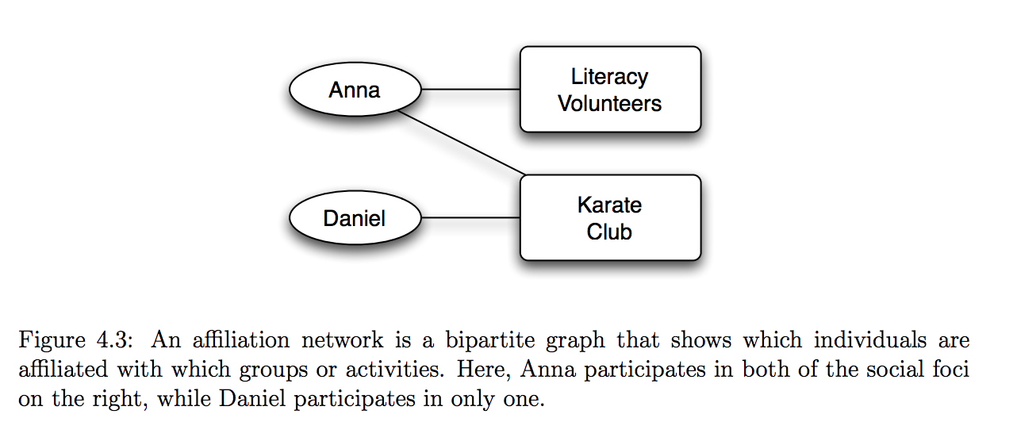
Affiliation
Contextual factors (organizations, companies, hobby, etc.) also become a node in the network. Contextual factors named foci – focal points.

Slide 7
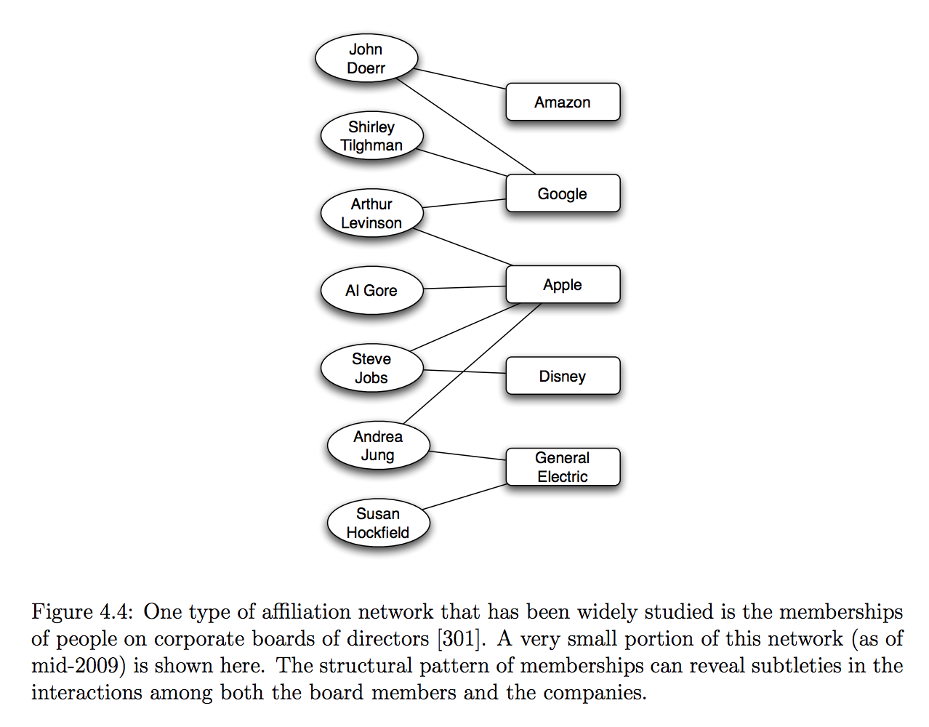
Affiliation

Slide 8
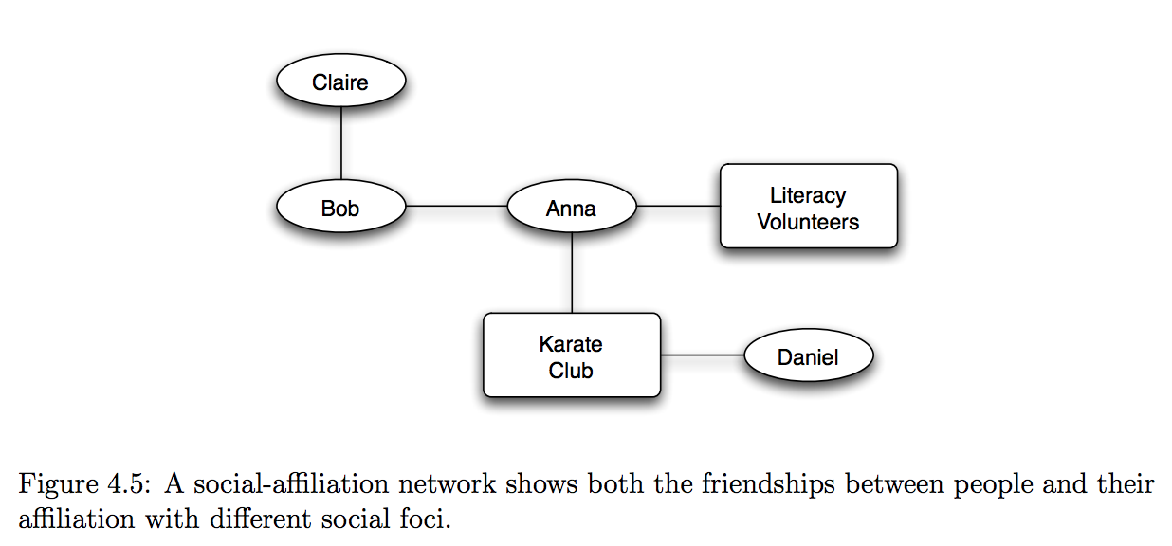
Coevolution of social and affiliation networks
Both social networks and affiliation networks change over time -> coevolution may influence the other
Social-affiliation network representation

Slide 9
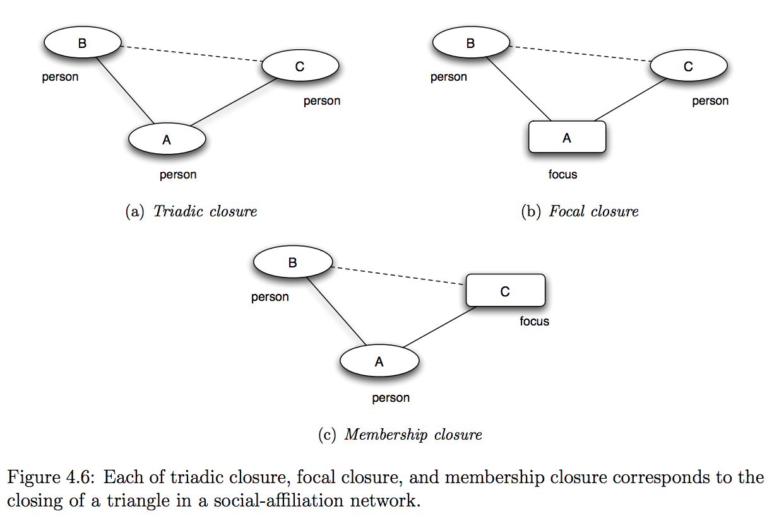
Understand the role of different mechanisms play in forming links
a). A introduces B to C
b). Activity A introduces both B and C
c). A introduces B to activity C

Slide 10
Tracking link formation in online data
Question: how much more likely is an edge to form if they have multiple friends in common as compared to 1 friend, 2 friends?

Slide 11
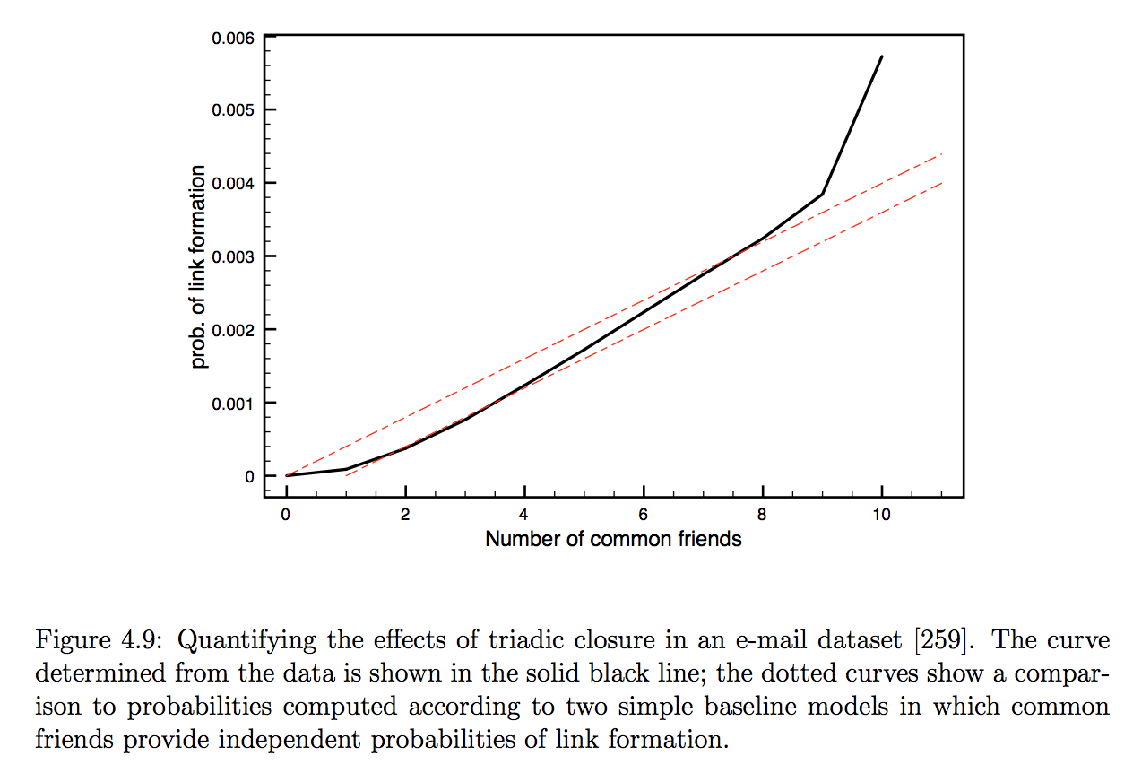
An example
2 snapshots of network at different times
for each k, identify all pairs of nodes who have exactly k friends in common at first time period but have not formed a link yet
T(k):= fraction of pairs formed an edge by the time of the second snapshot

Slide 12
An example cont.
comparison with baseline models
T_b(k) = 1 – (1-p)^k each common friend that two people have in common give them an independent probability p of forming an link each day (dotted line – linear fashion)
Plots suggest the independent assumption about the common friends may not hold

Slide 13
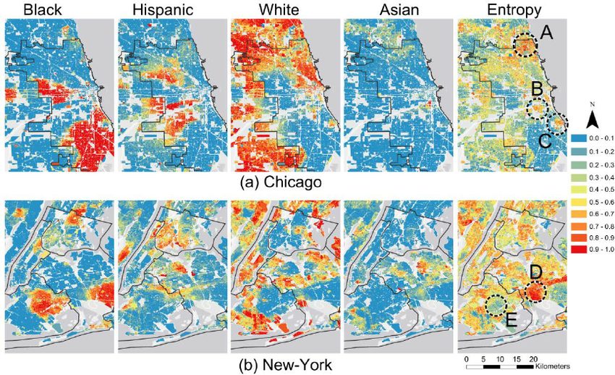
Schelling’s Model
http://nifty.stanford.edu/2014/mccown-schelling-model-segregation/

Slide 14
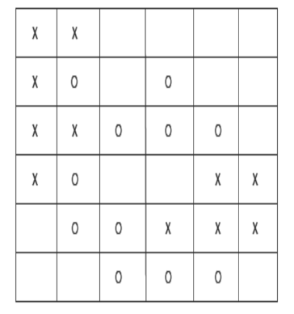
Model Assumptions
Population of individuals called agents
Each agent of type X or type O
The two types represent some characteristic as basis for homophily (race, ethnicity, country of origin, or native language)
Agents reside in cells of a grid (simple model of a 2‐D city map)
Some cells contain agents while others are unpopulated
Cell’s neighbors: cells that touch it (including diagonal contact)

Slide 15
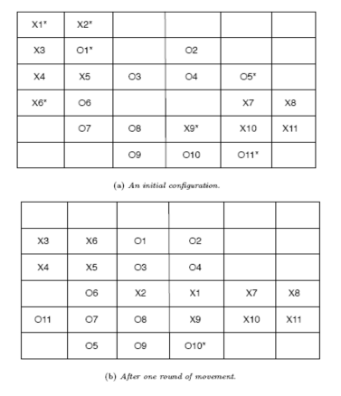
Local Mechanism
Each agent wants to have at least some t other agents of its own type as neighbors (t the same for all)
Unsatisfied agents have fewer than t neighbors of the same type as itself and move to a new cell
Unsatisfied agents move in rounds
Results are robust with respects to variations in movement issues

Slide 16
Result Interpretation
Spatial segregation is taking place even though no individual agent is explicitly seeking it
T = 3 implies that agents just want to avoid being too extreme minority in their own area
Theoretically, complete integration is achievable.
From a random start, it is very hard for the collection of agent to find such integrated patterns. More typically, agents form larger clusters
Local preferences of individual agents have produced a global pattern that none of them necessarily intended.

